Slide 1
The Transmission of Monetary Policy to Household Wealth Channels
Method: Deep Reinforcement Learning

Slide 2
The Transmission of Monetary Policy to Household Wealth Channels
Research Question (temporarily)
How does the transmission of monetary policy impact household wealth channels?
Method
I propose using deep reinforcement learning (DRL) to analyze the dynamics of household wealth channels in response to changes in monetary policy. DRL is well-suited for solving problems with high dimensionality and complexity. It also allows for heterogenous actions within a simulated environment, reflecting real choices of a household.

Slide 3
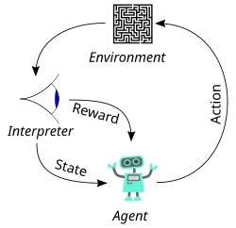
Deep Reinforcement Learning (DRL): A simple case

Slide 4
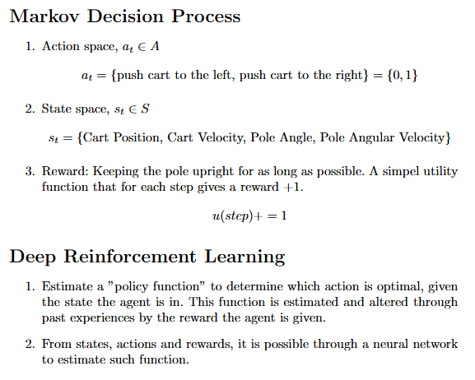
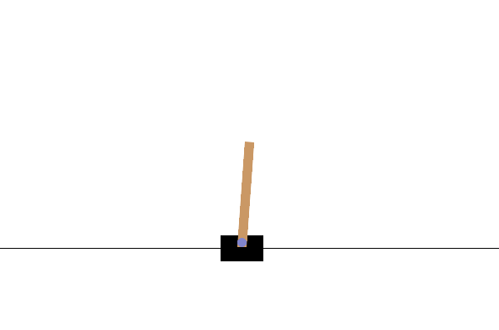
Deep Reinforcement Learning (DRL): A simple case

Slide 5
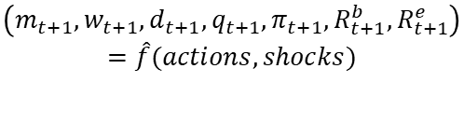

Connecting DRL to Economics (and the RQ)
Agent = Household
Policy by Neural Network: Consume, labour hours, debt, investments Estimated by ANN
Agent decide actions
Agent Observes state
Policy update
Reinforcement Learning
Action:
Consumption
Labour hours
Obtain debt
Allocate resources to investments (bonds, equities and housing)
States:
$$(m_{t}, w_{t},d_{t}, q_{t, }π_{t},R_{t}^{b},R_{t}^{e})$$
Reward: Based on consumption, house holdings and disutility from labour hours
Environment Actions and Shocks
$$\left(m_{t+1},w_{t+1},d_{t+1},q_{t+1},π_{t+1},R_{t+1}^{b},R_{t+1}^{e}\right)=\hat{f}(actions, shocks)$$
Agent recieves reward from actions

Slide 6
Working Process
At the moment
Code almost running
Finishing up the math aswell
To compare my results with empirics
Moment matching (empirics vs. simulation)
Distributional Analysis
Use impulse response functions to identify the transmission from MP to household decisions

Slide 7
Appendix

Slide 8
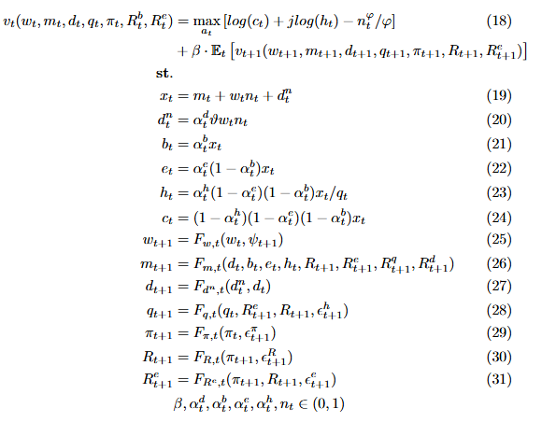
Bellman Equation (The household optimization problem)
Your take on the current Bellman Equation
Improvements to the current problem
Economic sense
Reflecting a semi-real-world scenario

Slide 9

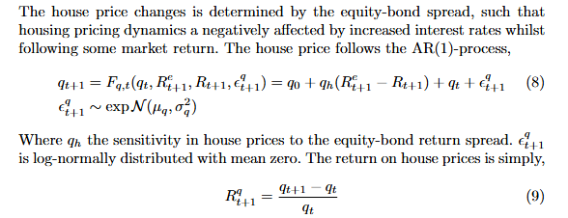
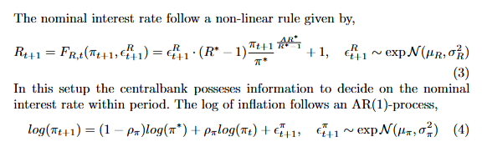
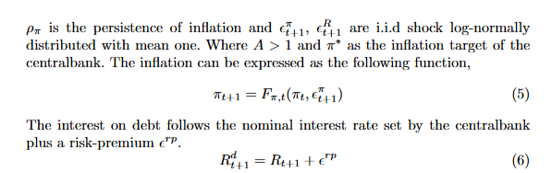



Bellman Equation (The household optimization problem)

Slide 10
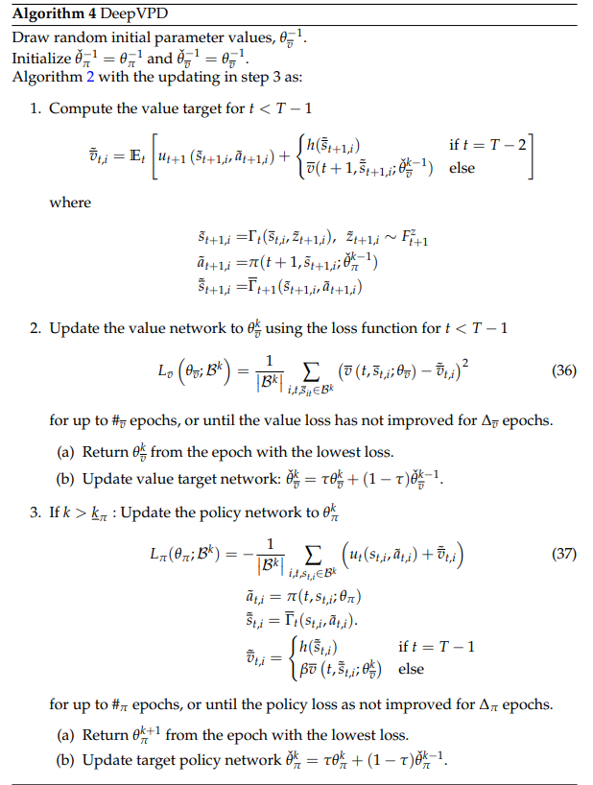
Full Algorithm (DeepVPD)

